Slide 1

Masters in Mechanical System Design from IIT Kharagpur, India
PhD in Machine learning and fault diagnosis from University of Lille, France

Slide 2
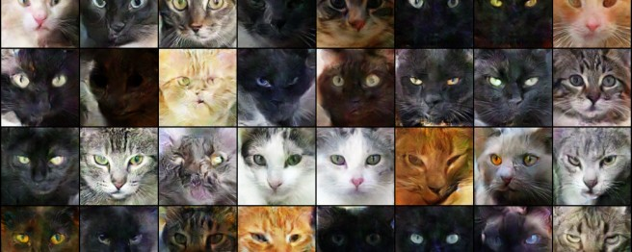

What is Visual Anomaly Detection
Normal
Anomaly

Slide 3
The problem formulation
Out of distribution detection We do not use classification algorithms
We use anomaly detection

Slide 4
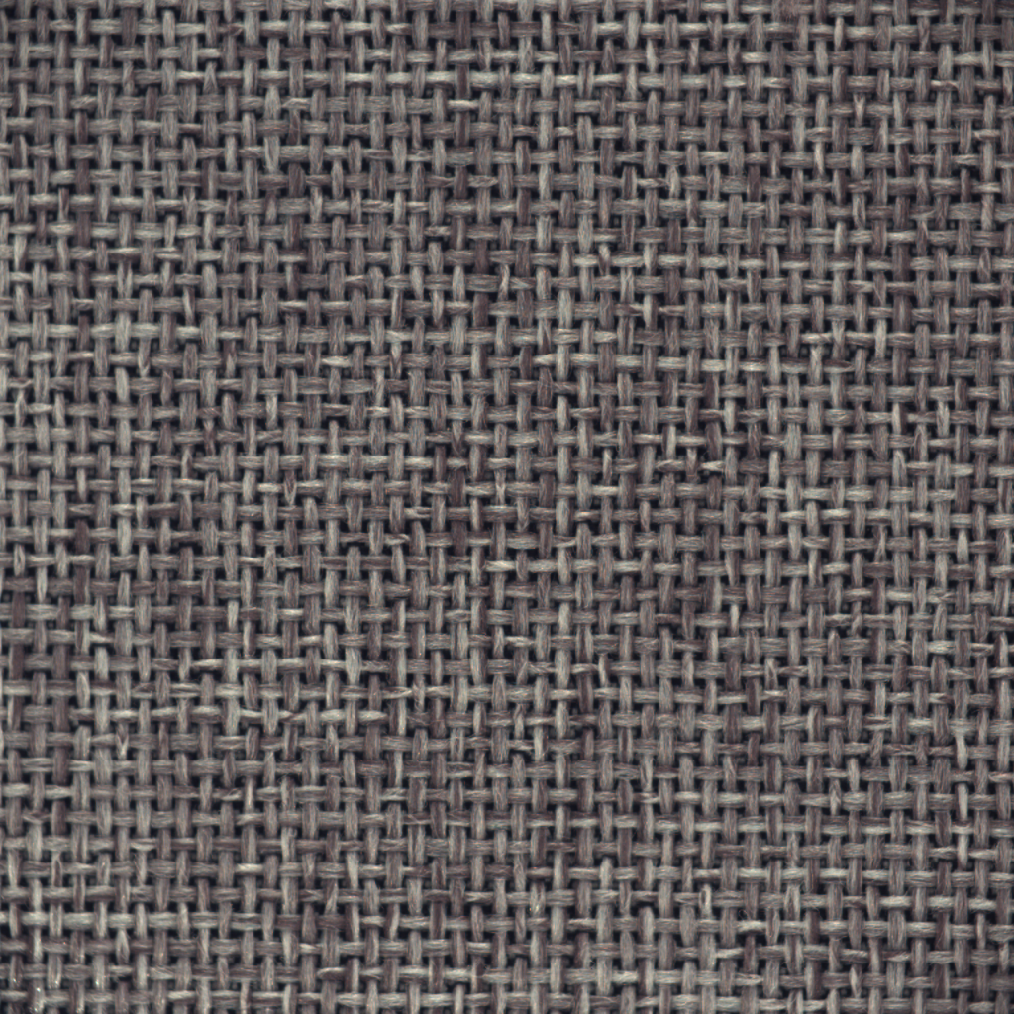
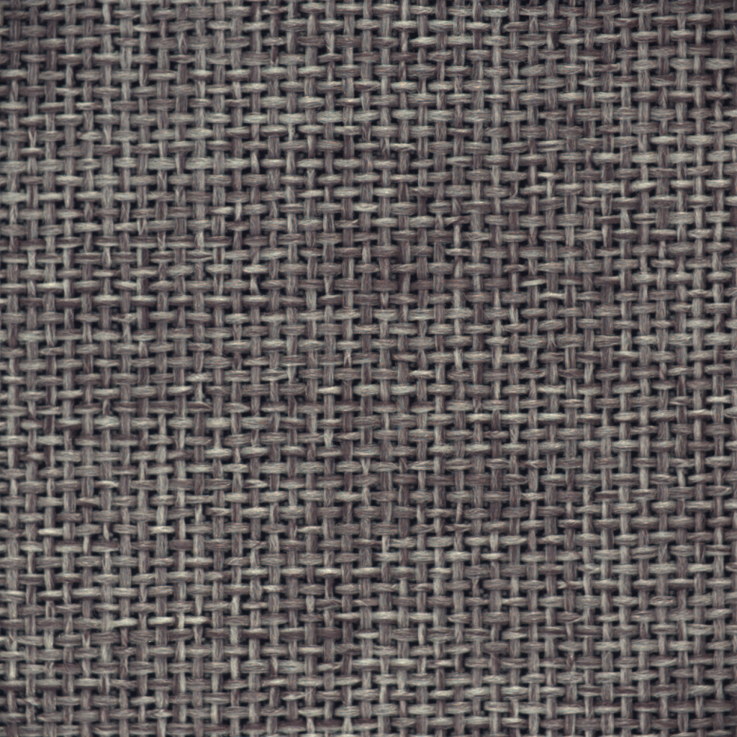
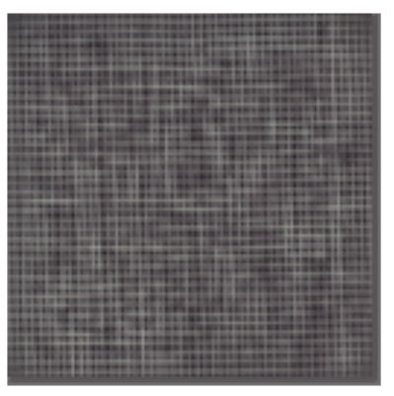
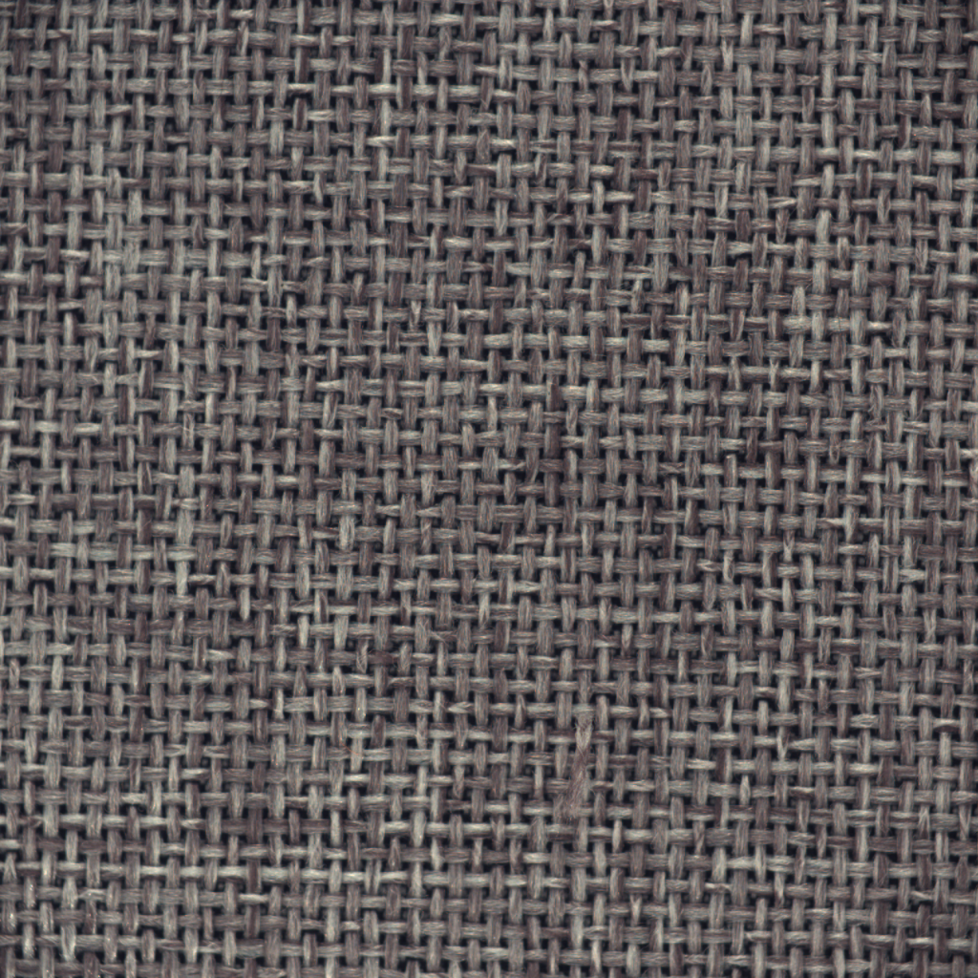
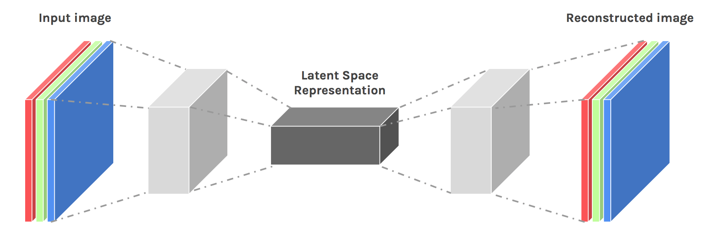
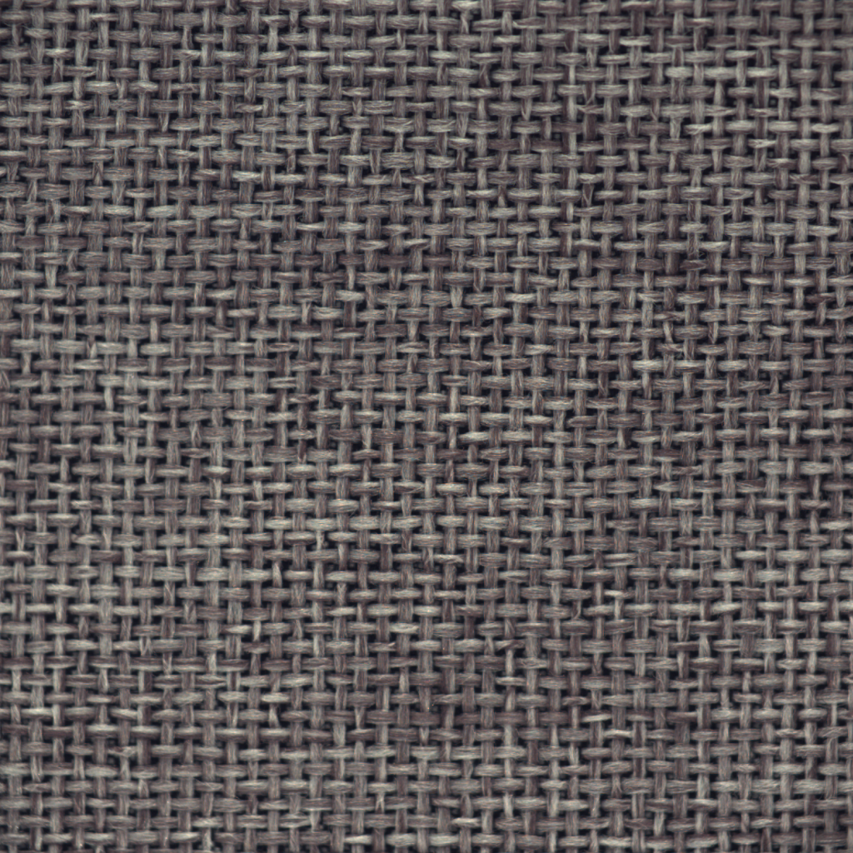
The naïve method
Normal
Autoencoder
Reconstruction
Tensor of shape
(3,256,256)
Tensor of shape
(3,256,256)
Anomaly Score = MSE( - )

Slide 5
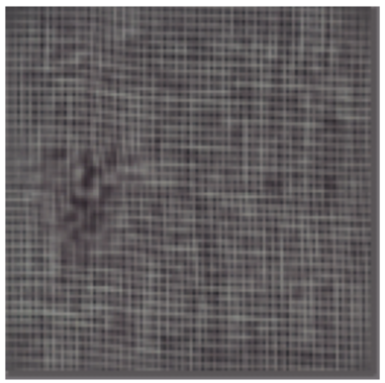
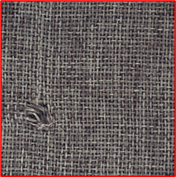
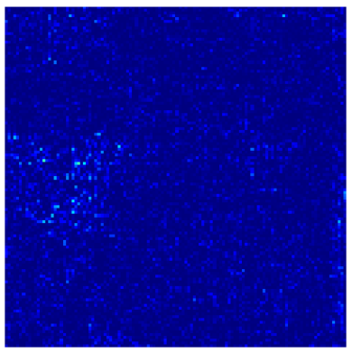
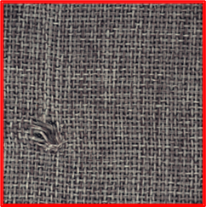
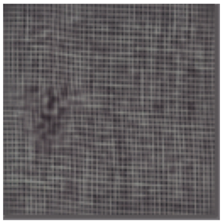
Why this out of distribution task is so difficult ?
Abnormal
Autoencoder
Reconstruction
Tensor of shape
(3,256,256)
Tensor of shape
(3,256,256)
Tensor of shape
(1,256,256)
Anomaly Score = MSE( - ) =

Slide 6
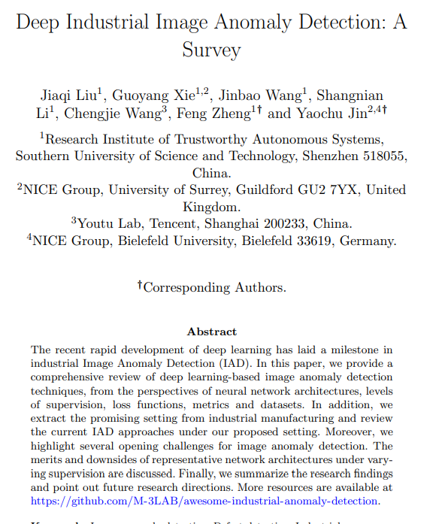
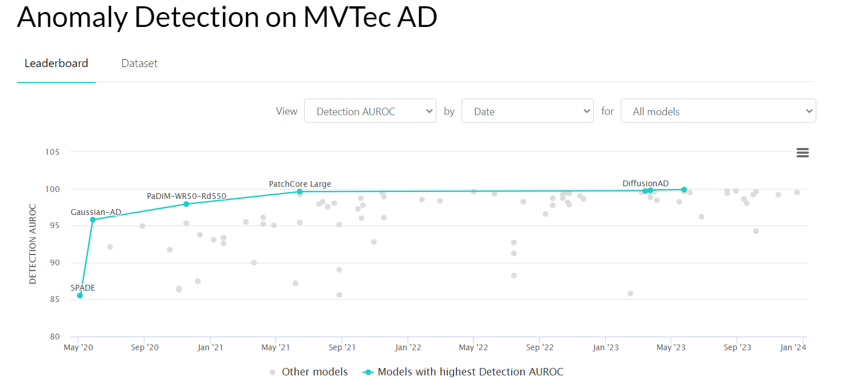
Resources
Deep Industrial Image Anomaly Detection: A Survey
Data Set – https://www.mvtec.com/company/research/datasets/mvtec-ad

Slide 7

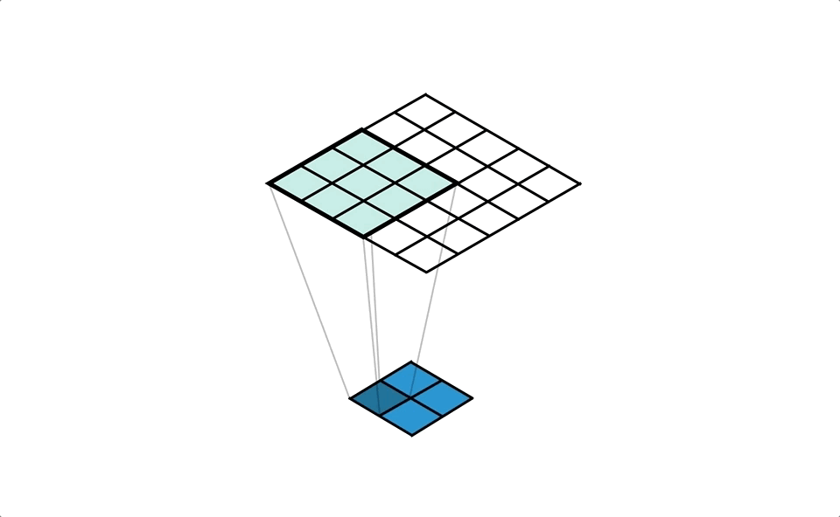
Convolution and Transposed Convolution
Normal
Autoencoder
Reconstruction

Slide 8
Convolution and Transposed Convolution
Normal
Autoencoder
Reconstruction

Slide 9
Abnormal
Autoencoder
Reconstruction
Tensor of shape
(3,256,256)
Tensor of shape
(3,256,256)
Tensor of shape
(1,256,256)
Anomaly Map = MSE( - ) =
Anomaly Score = MEAN( ) = 0.334 (a single number)

Slide 10
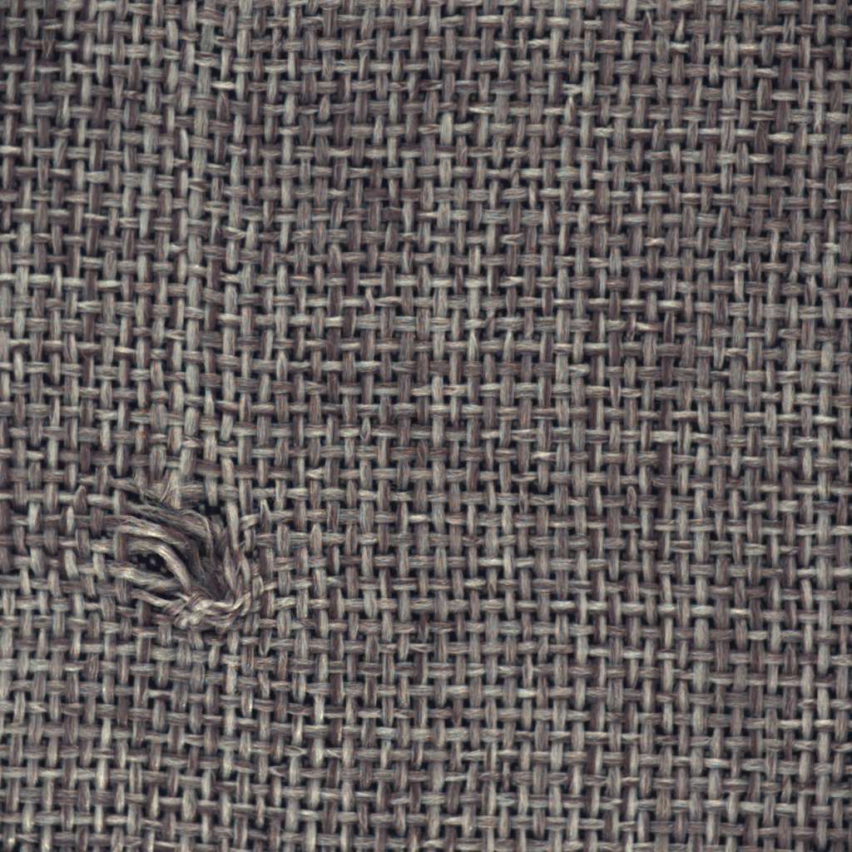
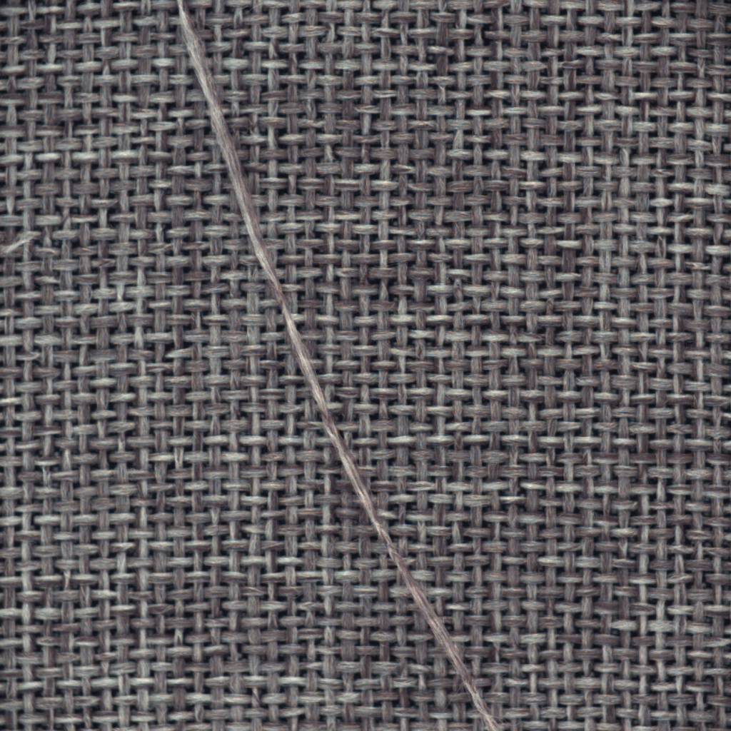
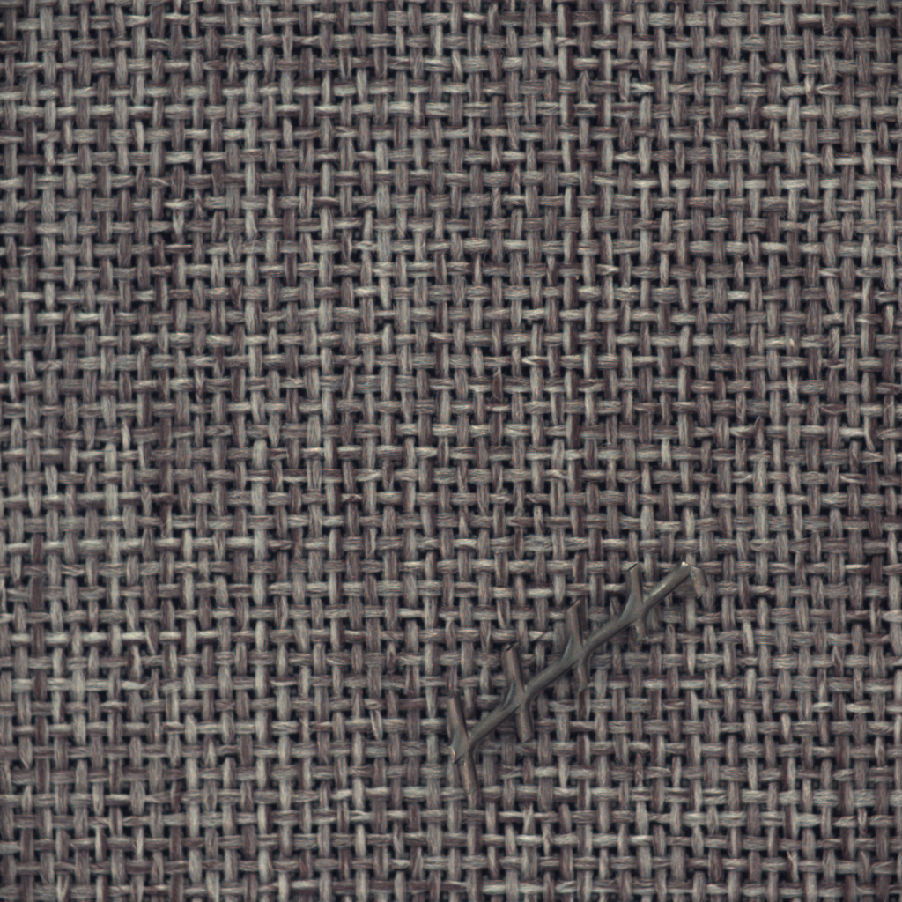
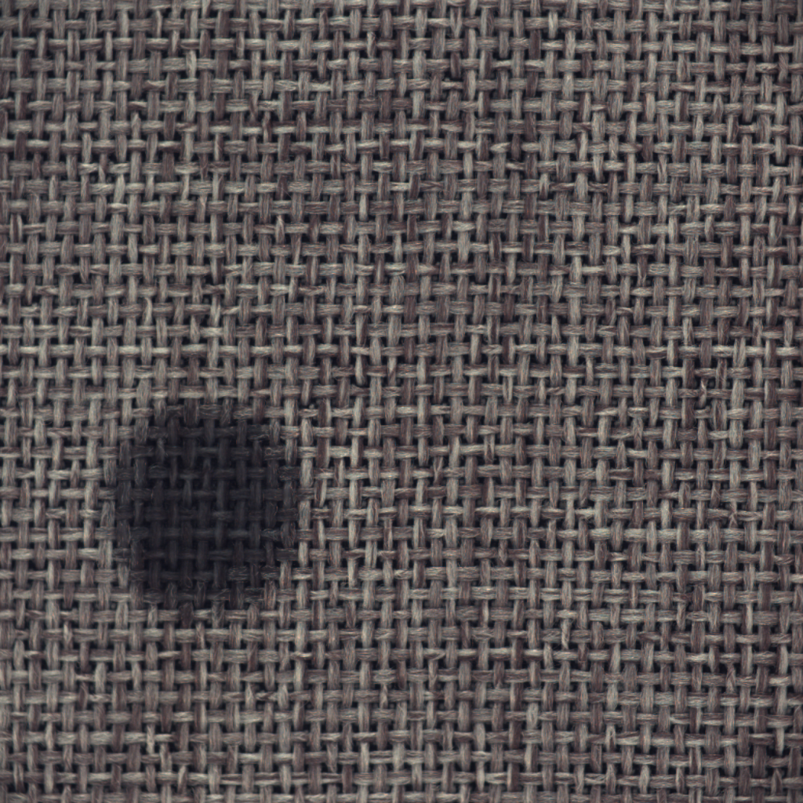
Anomaly score
Autoencoder
Normal
Set the threshold
0.00224
0.0034
0.0044
Anomaly score axis

Slide 11


$$μ+3∗σ$$
Set the threshold
Assume to be normal distribution
0.00224
$$μ$$
0.0034
0.0044
Anomaly score axis

Slide 12
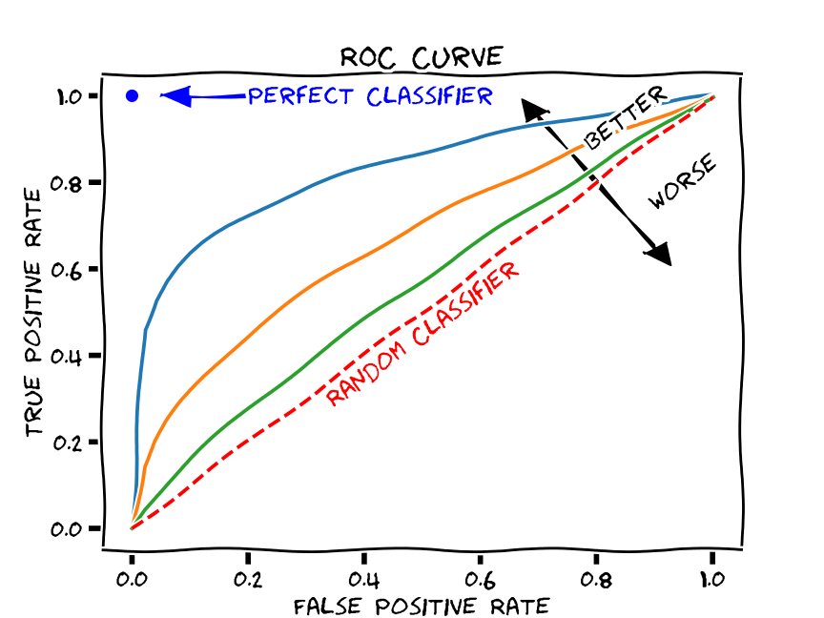

Slide 13
Real life example of industrial data
Normal
Very high number
of images
Abnormal
Very low number
of images

Slide 14
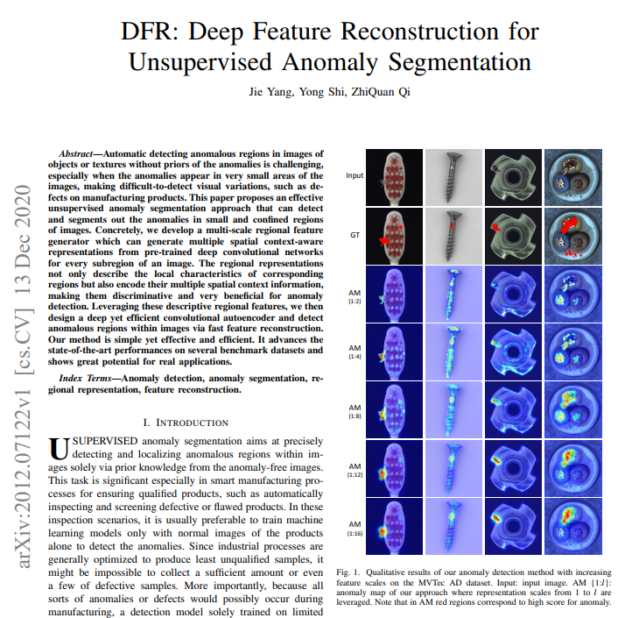

Slide 15
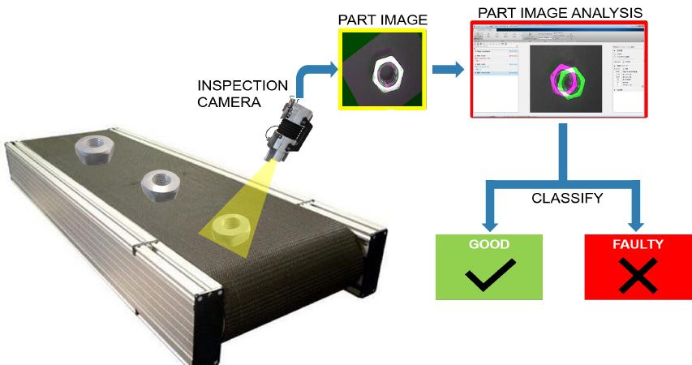
Application in the industry (inspection during production)

Slide 16
The naïve method
Normal
Autoencoder
Reconstruction
Tensor of shape
(3,256,256)
Tensor of shape
(3,256,256)
Anomaly Score = MSE( - )

Slide 17
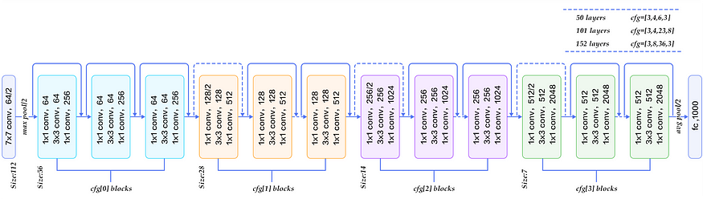
Normal
Pretrained resnet 50 model
(2048)
(512, 28, 28)
(1024, 14, 14)

Slide 18
How to aggregate the features
Extracted features
Normal
(512, 28, 28)
(3, 224, 224)
(1536, 28, 28)
Up scale
(1024, 28, 28)
(1024, 14, 14)

Slide 19
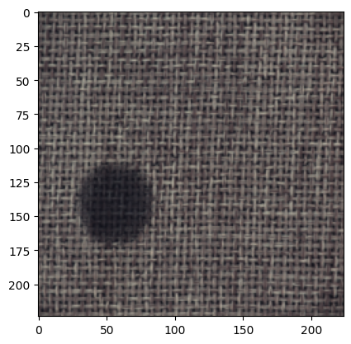
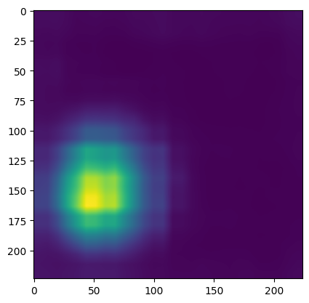
How to train an autoencoder
Reconstructed features
Extracted features
Backbone
Resnet
(3, 224, 224)
(1536, 28, 28)
(1536, 28, 28)
MSE
Mean of top 10 values
Anomaly Score
(28, 28)
Anomaly Map

Slide 20
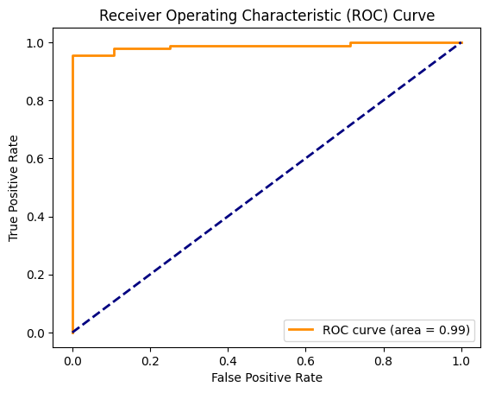
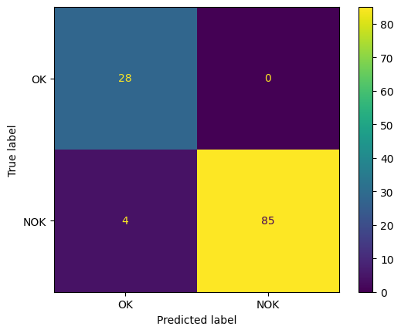
Results

Slide 22
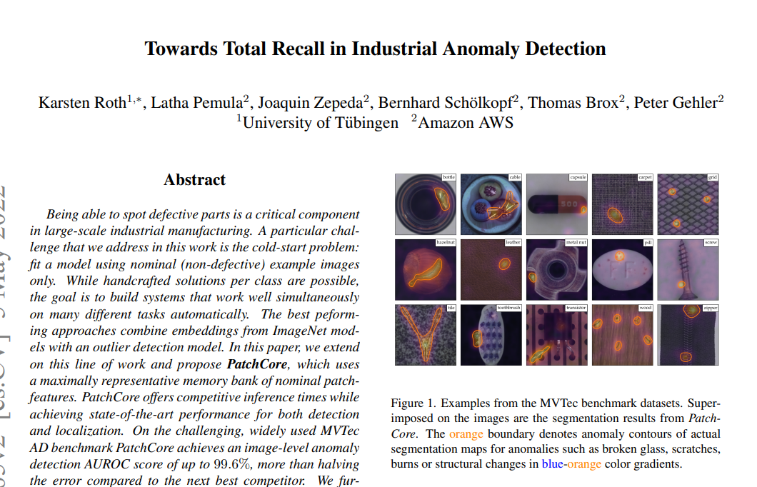

Slide 23
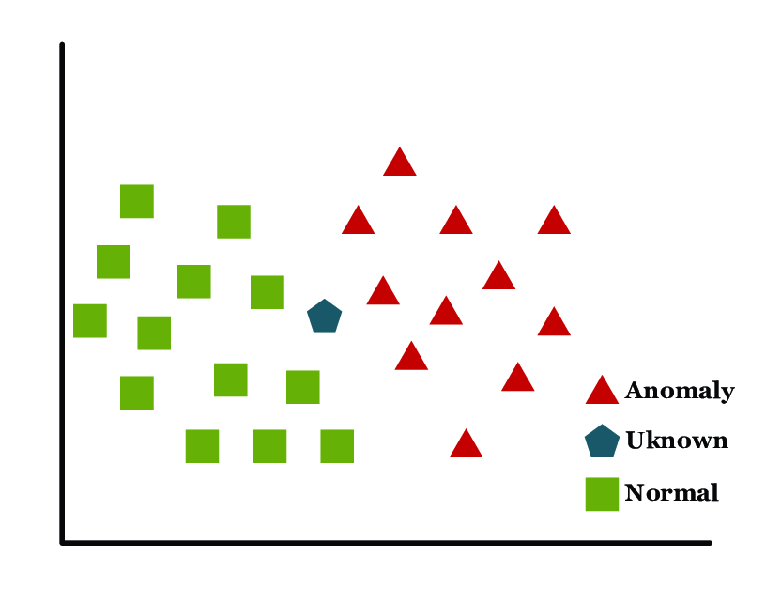
K nearest neighbours

Slide 24
K nearest neighbours for anomaly detection
Let, K = 3
Anomaly score B = d1+d2+d3
y
Anomaly score A = d1+d2+d3
Memory
Bank
x
Anomaly score B > Anomaly Score A

Slide 25
Normal
(3, 224, 224)
Pretrained Resnet-50 model
(2048)
Memory Bank
 | 1 | 2 | … | 2048
1
2
…
100
(100, 3, 224, 224)
(100, 2048)

Slide 26
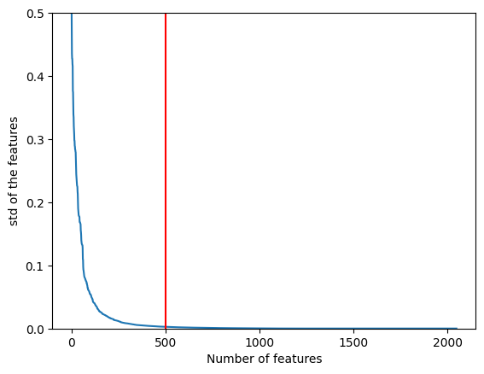
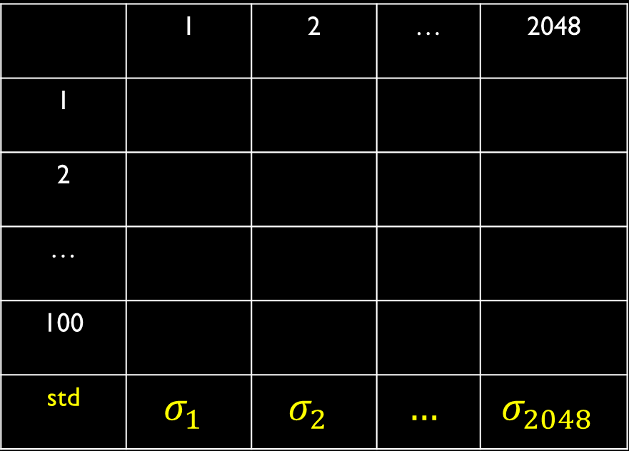
 | 1 | 2 | … | 2048
1
2
…
100
std | $$σ_{1}$$ | $$σ_{2}$$ | $$…$$ | $$σ_{2048}$$
 | 1 | 2 | … | 500
1
2
…
100
Select 500 columns having high variance
Memory Bank

Slide 27
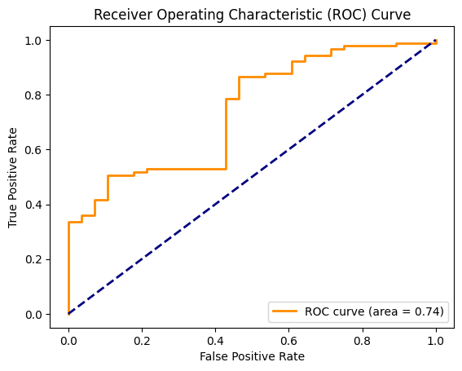
But The results are not very good
Patch Comparison

Slide 28
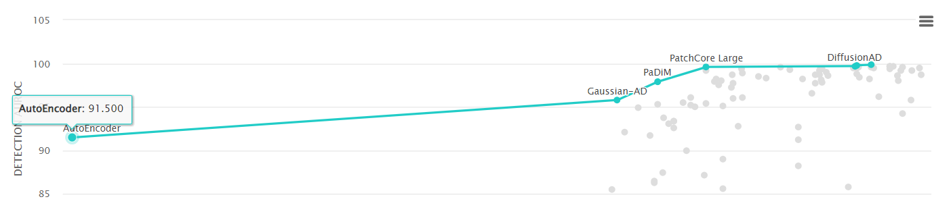
Part -2 of PatchCore explanation`
Notes:
Hey everyone! Welcome back to Intelligent Machines where we discuss about learning the latest in industrial anomaly detection. Today, we're diving into Part 2 of the PatchCore paper—a fascinating approach to anomaly detection. But hang tight, because I've got a little surprise for you at the end of this video that you won’t want to miss!

Slide 29
K nearest neighbours for anomaly detection
Let, K = 1
y
Memory
Bank
x
Notes:
In our last video , we explored distance-based algorithms and how anomaly detection is performed using K-nearest neighbors. We used a RESNET model to extract features from images. Today, we'll zoom in on how PatchCore takes this a step further by focusing on individual patches of an image rather than the whole image. Intrigued? Let's get started! The green boxes represent small patches from good images. We use a pre-trained network to extract features from each patch and project them onto 2D space, as shown here. We call this collection of patches from good images the Memory Bank. When a new test image comes in, we extract its patches and compare each one to our memory bank using K-nearest neighbors. We measure the distance between each test patch and the patches in our memory bank. If a patch is normal, its distance to the nearest neighbor will be small. If it's anomalous, the distance will be larger.

Slide 30
Normal
Pretrained resnet 50 model
(2048)
(512, 28, 28)
(1024, 14, 14)
Notes:
SLIDE 1: PatchCore Overview
"So, what exactly is PatchCore? Imagine we have a normal image. Instead of analyzing the entire image for anomalies, we break it down into smaller patches. Using a pre-trained RESNET model, we extract features—not from the last layer, but from intermediate layers. For instance, we might use features from the second and third layers."

Slide 31
How to aggregate the features
Extracted features
Normal
(512, 28, 28)
(3, 224, 224)
(1536, 28, 28)
Up scale
(1024, 28, 28)
(1024, 14, 14)
Notes:
Feature Aggregation
"Next, we combine these features using an aggregation method called adaptive average pooling. This reduces our image from a size of 3x224x224 to feature maps with 1536 channels and a spatial dimension of 28x28.

Slide 32
Patch Features
Patch
Extracted features
(1536, 1, 1)
Normal
(3, 224, 224)
(1536, 28, 28)
(1536, 28 x 28)
(1536, 784).T
(784, 1536)
Notes:
Now, let's focus on these patches. Each patch is a small segment of our feature map. With a feature dimension of 1536, and considering the spatial dimensions of 28x28, we get a total of 784 patches from a single image. Think of these as our mini-representations of the image, each holding crucial information.

Slide 33
Memory Bank of Patches
Memory Bank
…
Normal
(3, 224, 224)
Training Data
(784,1536)
(100, 3, 224, 224)
(78400, 1536)
Notes:
To perform anomaly detection, we create a memory bank. This involves generating patches from many normal images—say 100 images. That gives us a whopping 78,400 patches, each with 1536 features. This memory bank is what we use to compare new patches against.

Slide 34
Anomaly Detection with Memory Bank
Test Sample
…
Memory Bank
(78400, 1536)
 | 1 | 2 | … | 78400
1
2
…
784
d_Min_1
d_Min_2
d_Min_784
(784, 1536)
Notes:
We measure the distance between each test patch and the patches in our memory bank. If a patch is normal, its distance to the nearest neighbor will be small. If it's anomalous, the distance will be larger.
We calculate the minimum distance for each patch—these are our distance scores.

Slide 35
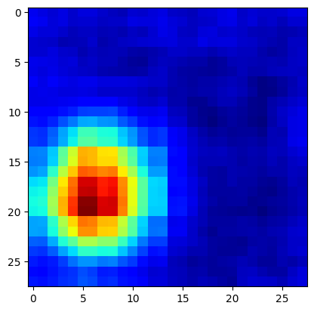
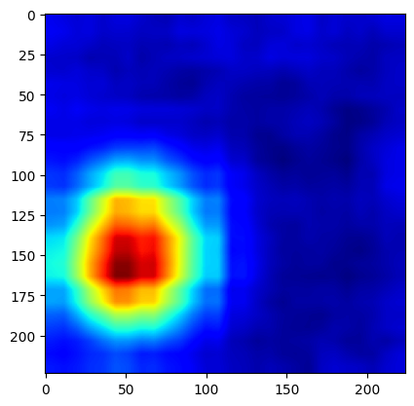
Test Sample
Distance_score
d_Min_1
d_Min_2
Max
Anomaly Score (s_star)
…
d_Min_784
Reshape
(28 x 28)
(224 x 224)
Notes:
From these distance_scores, the maximum value becomes our anomaly score, indicating the patch that deviates the most from normal.
Finally, we reshape our 784 distance scores to a 28x28 grid to create a heatmap. We use bilinear interpolation to upsample this heatmap and overlay it on the original image, making anomalies visually stand out.
[ENDING]
"And there you have it—the core concepts of the PatchCore algorithm. This method provides a robust way to detect anomalies by focusing on small image patches rather than the whole image.
But here's the surprise I promised: Its about the memory bank. Thank you for watching Intelligent Machines. If you enjoyed this video, give it a thumbs up, share it with your friends, and leave a comment if you have any questions or topics you'd like us to cover next. See you next time!

